Slide 1














Finding good parameters
Is there a simple way to find parameter values $w,b$ that give me least loss?
Age | Highest education (HS, BT, MT, PhD) |  |  |  | Gender (M, F, O) |  |  | True Salary
$$x_{1}$$ | $$x_{2}$$ | $$x_{3}$$ | $$x_{4}$$ | $$x_{5}$$ | $$x_{6}$$ | $$x_{7}$$ | $$x_{8}$$ | $$y$$
45 | 0 | 0 | 1 | 0 | 1 | 0 | 0 | 64475
22 | 0 | 1 | 0 | 0 | 0 | 1 | 0 | 34179
28 | 1 | 0 | 0 | 0 | 1 | 0 | 0 | 34573
34 | 0 | 0 | 1 | 0 | 0 | 1 | 0 | 50882
47 | 1 | 0 | 0 | 0 | 0 | 1 | 0 | 38660
55 | 0 | 0 | 1 | 0 | 1 | 0 | 0 | 71487
49 | 0 | 0 | 0 | 1 | 0 | 1 | 0 | 79430
27 | 0 | 1 | 0 | 0 | 0 | 0 | 1 | 34355
25 | 0 | 1 | 0 | 0 | 1 | 0 | 0 | 43837
We suspect that the following law holds
$\hat{y}=b+d⋅x_{1}+p⋅x_{2}+q⋅x_{3}+r⋅x_{4}+s⋅x_{5}+k⋅x_{6}+l⋅x_{7}+m⋅x_{8}$
Actually, just a linear model $\hat{y}=b+w^{⊤}x$
$x=\left[x_{1},x_{2},x_{3},x_{4},x_{5},x_{6},x_{7},x_{8}\right]$
$w=\left[d,p,q,r,s,k,l,m\right]$
Use average loss to find good params $ℓ\left(w,b\right)≝\frac{1}{n}\sum_{i=1}^{n}{{\left({\hat{y}}^{i}−y^{i}\right)}^{2}}$ $=\frac{1}{n}\sum_{i=1}^{n}{{\left(\left(w^{⊤}x^{i}+b\right)−y^{i}\right)}^{2}}$
$x^{i}=\left[x_{1}^{i},x_{2}^{i},x_{3}^{i},x_{4}^{i},x_{5}^{i},x_{6}^{i},x_{7}^{i},x_{8}^{i}\right]$ is the feature vector for the i-th person in our training set
Oh, of course! You are already familiar with it. It is called calculus.
Clearly, we don’t agree on the definition of the word “simple”

Slide 2
calculus crash course
it is said that both Gottfried Leibniz and Isaac Newton felt that the other person’s work was a bit … derivative

Slide 3

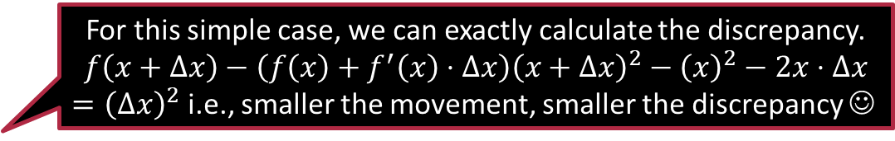





Derivatives
For this simple case, we can exactly calculate the discrepancy.
$$f\left(x+Δx\right)−\left(f\left(x\right)+f^{′}\left(x\right)⋅Δx\right){\left(x+Δx\right)}^{2}−{\left(x\right)}^{2}−2x⋅Δx$$ $={\left(Δx\right)}^{2}$ i.e., smaller the movement, smaller the discrepancy ☺
2.5
Case 1: $x=0.5, Δx=0.1$ $f\left(x\right)=0.25,f^{′}\left(x\right)=1$ $f\left(x+Δx\right)=0.36$ $f\left(x\right)+f^{′}\left(x\right)⋅Δx=0.35$
Case 2: $x=1, Δx=0.1$ $f\left(x\right)=1,f^{′}\left(x\right)=2$ $f\left(x+Δx\right)=1.21$ $f\left(x\right)+f^{′}\left(x\right)⋅Δx=1.2$
Case 3: $x=−1.5, Δx=0.1$ $f\left(x\right)=2.25,f^{′}\left(x\right)=−3$ $f\left(x+Δx\right)=1.96$ $f\left(x\right)+f^{′}\left(x\right)⋅Δx=1.95$
$$=1$$
2
$=$2.25
1.5
$=$1.25
1
0.5
0
-2 -1.5 -1 -0.5 0 0.5 1 1.5 2
$$f\left(x\right)=x^{2}$$
$$f^{′}\left(x\right)=2x$$

Slide 4



Derivatives – Behind the Scenes
$f\left(x_{0}+Δx\right)≈f\left(x_{0}\right)+f^{′}\left(x_{0}\right)⋅Δx$
Can be obtained as a corollary of Taylor’s theorem
Holds only if $Δx$ is “small” otherwise this may not hold
If $Δx$ has the same sign as $f′\left(x_{0}\right)$ then $f\left(x_{0}+Δx\right)>f\left(x_{0}\right)$
If $Δx$ has opposite sign as $f′\left(x_{0}\right)$ then $f\left(x_{0}+Δx\right)<f\left(x_{0}\right)$
The derivative $f′\left(x_{0}\right)$ tells us two things
Its sign tells us in which direction will function value increase
Interpret $+$ve as “right” and $−$ve as “left”
E.g., $f^{′}\left(x_{0}\right)<0$ tells me that $f$ will increase if I decrease $x$ from $x_{0}$ a bit
Its magnitude gives an idea how much function value will change
Rearranging this equation gives me $f^{′}\left(x_{0}\right)≈\frac{f\left(x_{0}+Δx\right)−f\left(x_{0}\right)}{Δx}$

Slide 5




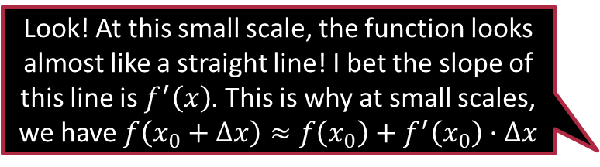
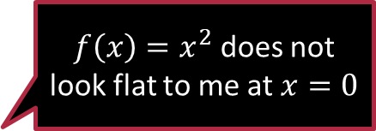
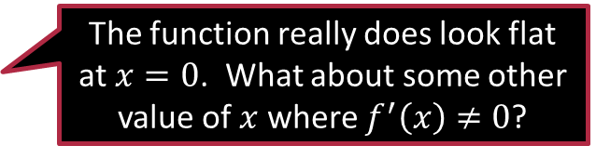
Stationary points
These are places where the derivative vanishes i.e. is 0
These could be a local minimum, a global minimum a local maximum, global maximum, or a saddle point
Derivative being zero at a point is its way of telling us that the function looks flat around that point
$f\left(x\right)=x^{2}$ does not look flat to me at $x=0$
Yup! In fact, it looks like the function value will increase both to the left and the right
Look! At this small scale, the function looks almost like a straight line! I bet the slope of this line is $f^{′}\left(x\right)$. This is why at small scales, we have $f\left(x_{0}+Δx\right)≈f\left(x_{0}\right)+f^{′}\left(x_{0}\right)⋅Δx$
Tangent line/plane
The function really does look flat at $x=0$. What about some other value of $x$ where $f^{′}\left(x\right)≠0$?
Remember kids, such effects are visible only when we are look at very small scales. Let me zoom in to show you

Slide 6
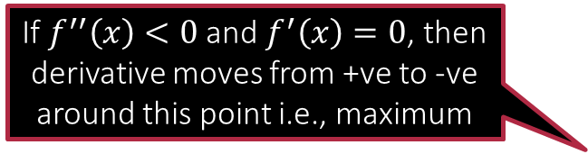



Stationary points
If $f^{′′}\left(x\right)<0$ and $f^{′}\left(x\right)=0$, then derivative moves from +ve to -ve around this point i.e., maximum
Can find out if a stationary point is a max. or min. using 2nd derivative
$f^{′′}\left(x\right)=d^{′}\left(x\right)$ where we define $d\left(x\right)≝f^{′}\left(x\right)$
Sign of $f^{′′}\left(x\right)$ tells us in which direction will $f^{′}\left(x\right)$ increase
Its magnitude gives us an idea how much $f^{′}\left(x\right)$ will change
Also, no general way of telling if a max/min is local or global
If $f^{′′}\left(x\right)=0$ and $f^{′}\left(x\right)=0$, then this may be min or max or saddle – higher derivatives e.g., $f^{′′′}\left(x\right)$ needed
If $f^{′′}\left(x\right)>0$ and $f^{′}\left(x\right)=0$, then derivative moves from -ve to +ve around this point i.e., minimum

Slide 7

Rules of derivatives
In the following we have $f,g:ℝ→ℝ$
Sum Rule: ${\left(f\left(x\right)+g\left(x\right)\right)}^{′}=f^{′}\left(x\right)+g^{′}\left(x\right)$
Scaling Rule: ${\left(a⋅f\left(x\right)\right)}^{′}=a⋅f^{′}\left(x\right)$ if $a∈ℝ$ is a constant
Product Rule: ${\left(f\left(x\right)⋅g\left(x\right)\right)}^{′}=f^{′}\left(x\right)⋅g\left(x\right)+g^{′}\left(x\right)⋅f\left(x\right)$
Quotient Rule: $\left(f\left(x\right)/g\left(x\right)\right)′=\left(f^{′}\left(x\right)⋅g\left(x\right)−g^{′}\left(x\right)f\left(x\right)\right)/{\left(g\left(x\right)\right)}^{2}$
Chain Rule: ${\left(f\left(g\left(x\right)\right)\right)}^{′}≝{\left(f∘g\right)}^{′}\left(x\right)=f^{′}\left(g\left(x\right)\right)⋅g^{′}\left(x\right)$
Chain rule commonly used when $f$ is a function of $t$ and $t=g\left(x\right)$ is dependent on $x$

Slide 8

Exercise
Melbo claims that the following function is continuous and differentiable at $x=\frac{π}{4}$ for a secret value of $m$ and $b$. Find them! $f\left(x\right)=\left\{\begin{matrix}\begin{matrix}\sin\left(x\right) & x≤\frac{π}{4}\end{matrix} \\ \begin{matrix}mx+b & x>\frac{π}{4}\end{matrix}\end{matrix}\right.$
Use the following identity and derivative rules to show $\frac{de^{x}}{dx}=e^{x}$. $e^{x}=1+x+\frac{x^{2}}{2!}+\frac{x^{3}}{3!}+\frac{x^{4}}{4!}+\frac{x^{5}}{5!}+…$

Slide 9
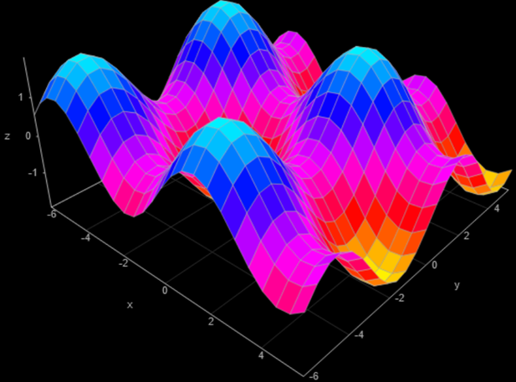
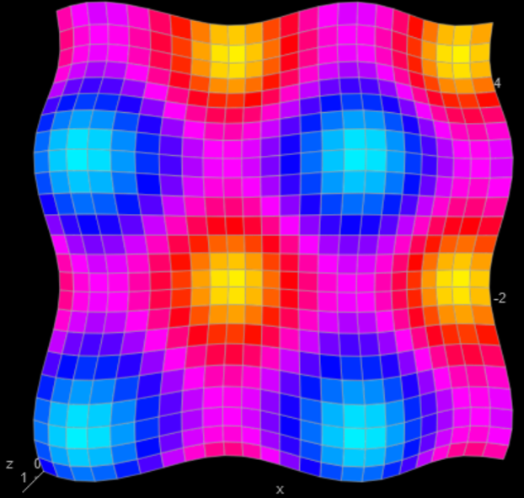

Multivariate Functions $f:ℝ^{2}→ℝ$
Saddle
Minimum
Maximum

Slide 10



Multivariate derivatives aka Gradients
Aha! So, a gradient is like a bunch of coordinate-wise derivatives arranged in the form of a vector!
For a function $f:ℝ^{d}→ℝ$ where the input has $d$ coordinates, we simply repeat the process for each coordinates to define the gradient as $∇f\left(x\right)=\left(\frac{∂f}{∂x_{1}},\frac{∂f}{∂x_{2}},…,\frac{∂f}{∂x_{d}}\right)$
Consider $f\left(x,y\right)$ a function from $ℝ^{2}→ℝ$
Trick: convert the problem into analyzing functions $ℝ→ℝ$ as we know them
$\frac{∂f}{∂x}$ at a point $\left(x_{0},y_{0}\right)$ is the derivative of $f$ w.r.t $x$ treating $y_{0}$ as const
The sign of $\frac{∂f}{∂x}$ tells us if $f$ will $↑$ or $↓$ if we increase $x$ slightly (keeping $y$ const)
The magnitude of $\frac{∂f}{∂x}$ tells us how sharply $f$ changes upon changing $x$
$\frac{∂f}{∂y}$ at a point $\left(x_{0},y_{0}\right)$ is the derivative of $f$ w.r.t $y$ treating $x_{0}$ as const
The sign of $\frac{∂f}{∂y}$ tells us if $f$ will $↑$ or $↓$ if we increase $y$ slightly (keeping $x$ const)
The magnitude of $\frac{∂f}{∂y}$ tells us how sharply $f$ changes upon changing $y$
The vector $\left(\frac{∂f}{∂x},\frac{∂f}{∂y}\right)≝∇f\left(x_{0},y_{0}\right)$ is called the gradient of $f$

Slide 11






Gradients for $f:ℝ^{2}→ℝ$
The gradient vector only tells me how the function value changes if I change one coordinate keeping all other coordinates fixed. What if I want to change multiple coordinates at the same time?
$$f\left(x,y_{0}\right)$$
$$\left(x_{0},y_{0}\right)$$
$$f\left(x_{0},y\right)$$
Stationary points are those points where the gradient vector is all zeros i.e., the function looks flat in all directions. As in 1D case, maxima, minima, saddle points all stationary.

Slide 12

Steepest ascent
$f\left(x^{0}+t\right)≈f\left(x^{0}\right)+t^{⊤}∇f\left(x^{0}\right)$
where $t=\left(t_{1},t_{2},…,t_{d}\right)∈ℝ^{d}$ and $f:ℝ^{d}→ℝ$, if $t$ is “small”
A fancy way of saying $f\left(x^{0}+t\right)≈f\left(x^{0}\right)+\sum_{i=1}^{d}{t_{i}⋅\frac{∂f}{∂x_{i}}}$
Claim: The direction of the gradient vector offers the biggest increase in function value out of all directions
Proof: Suppose we are only allowed to take a step of length $ε$ i.e., ${\left\|t\right\|}_{2}=ε$. Recall that $t^{⊤}∇f\left(x\right)=ε ⋅{\left\|∇f\right\|}_{2}⋅\cos\left(θ\right)$ where $θ$ is the angle between the vectors $t$ and $∇f\left(x\right)$. To get the max increase in $f$ value, we must increase $\cos\left(θ\right)$ as much as possible which happens when $θ=0$ i.e., $t$ and $∇f\left(x\right)$ are in the same direction.

Slide 13


Steepest descent
$f\left(x^{0}+t\right)≈f\left(x^{0}\right)+t^{⊤}∇f\left(x^{0}\right)$
where $t=\left(t_{1},t_{2},…,t_{d}\right)∈ℝ^{d}$ and $f:ℝ^{d}→ℝ$, if $t$ is “small”
A fancy way of saying $f\left(x^{0}+t\right)≈f\left(x^{0}\right)+\sum_{i=1}^{d}{t_{i}⋅\frac{∂f}{∂x_{i}}}$
Claim: The direction opposite to the gradient vector offers the biggest decrease in function value out of all directions
Proof: Suppose we are only allowed to take a step of length $ε$ i.e., ${\left\|t\right\|}_{2}=ε$. Recall that $t^{⊤}∇f\left(x\right)=ε ⋅{\left\|∇f\right\|}_{2}⋅\cos\left(θ\right)$ where $θ$ is the angle between the vectors $t$ and $∇f\left(x\right)$. To get the max decrease in $f$ value, we must decrease $\cos\left(θ\right)$ as much as possible which happens when $θ=π$ i.e., $t$ and $∇f\left(x\right)$ are in opposite directions.
I have a feeling this result will be very useful when we wish to minimize loss functions
Indeed! This simple-looking 2-line result is the key to powerful ML algorithms such as gradient descent and backpropagation

Slide 14

A Toy Example – Function output values
In this discrete toy example, we can calculate gradient at a point $\left(x_{0},y_{0}\right)$ as
$∇f\left(x_{0},y_{0}\right)=\left(\frac{Δf}{Δx},\frac{Δf}{Δy}\right)$ where
$\frac{Δf}{Δx}=\frac{f\left(x_{0}+1,y_{0}\right)−f\left(x_{0}−1,y_{0}\right)}{2}$
$\frac{Δf}{Δy}=\frac{f\left(x_{0},y_{0}+1\right)−f\left(x_{0},y_{0}−1\right)}{2}$
3 | 3 | 3 | 3 | 3 | 3 | 3 | 3 | 3
2 | 2 | 2 | 3 | 4 | 3 | 3 | 2 | 1
1 | 1 | 1 | 3 | 3 | 3 | 1 | 1 | 1
1 | 0 | 1 | 1 | 2 | 1 | 1 | 0 | 1
1 | 1 | 1 | 3 | 3 | 3 | 1 | 1 | 1
1 | 2 | 3 | 3 | 4 | 3 | 2 | 2 | 2
3 | 3 | 3 | 3 | 3 | 3 | 3 | 3 | 3
0 1 2 3 4 5 6
0 1 2 3 4 5 6 7 8

Slide 15

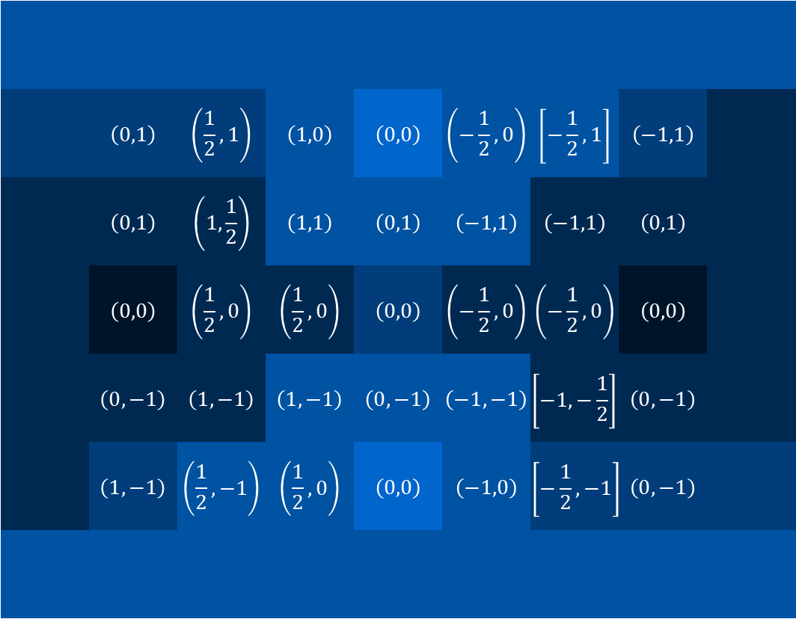
A Toy Example – Gradients
In this discrete toy example, we can calculate gradient at a point $\left(x_{0},y_{0}\right)$ as
$∇f\left(x_{0},y_{0}\right)=\left(\frac{Δf}{Δx},\frac{Δf}{Δy}\right)$ where
$\frac{Δf}{Δx}=\frac{f\left(x_{0}+1,y_{0}\right)−f\left(x_{0}−1,y_{0}\right)}{2}$
$\frac{Δf}{Δy}=\frac{f\left(x_{0},y_{0}+1\right)−f\left(x_{0},y_{0}−1\right)}{2}$
We can visualize these gradients using simple arrows as well
 | $$\left(0,1\right)$$ | $$\left(\frac{1}{2},1\right)$$ | $$\left(1,0\right)$$ | $$\left(0,0\right)$$ | $$\left(−\frac{1}{2},0\right)$$ | $$\left[−\frac{1}{2},1\right]$$ | $$\left(−1,1\right)$$
 | $$\left(0,1\right)$$ | $$\left(1,\frac{1}{2}\right)$$ | $$\left(1,1\right)$$ | $$\left(0,1\right)$$ | $$\left(−1,1\right)$$ | $$\left(−1,1\right)$$ | $$\left(0,1\right)$$
 | $$\left(0,0\right)$$ | $$\left(\frac{1}{2},0\right)$$ | $$\left(\frac{1}{2},0\right)$$ | $$\left(0,0\right)$$ | $$\left(−\frac{1}{2},0\right)$$ | $$\left(−\frac{1}{2},0\right)$$ | $$\left(0,0\right)$$
 | $$\left(0,−1\right)$$ | $$\left(1,−1\right)$$ | $$\left(1,−1\right)$$ | $$\left(0,−1\right)$$ | $$\left(−1,−1\right)$$ | $$\left[−1,−\frac{1}{2}\right]$$ | $$\left(0,−1\right)$$
 | $$\left(1,−1\right)$$ | $$\left(\frac{1}{2},−1\right)$$ | $$\left(\frac{1}{2},0\right)$$ | $$\left(0,0\right)$$ | $$\left(−1,0\right)$$ | $$\left[−\frac{1}{2},−1\right]$$ | $$\left(0,−1\right)$$
Saddle
Minimum
0 1 2 3 4 5 6
Maximum
0 1 2 3 4 5 6 7 8

Slide 16
A Toy Example – Gradients
Gradients converge toward a maxima from all directions
In this discrete toy example, we can calculate gradient at a point $\left(x_{0},y_{0}\right)$ as
$∇f\left(x_{0},y_{0}\right)=\left(\frac{Δf}{Δx},\frac{Δf}{Δy}\right)$ where
$\frac{Δf}{Δx}=\frac{f\left(x_{0}+1,y_{0}\right)−f\left(x_{0}−1,y_{0}\right)}{2}$
$\frac{Δf}{Δy}=\frac{f\left(x_{0},y_{0}+1\right)−f\left(x_{0},y_{0}−1\right)}{2}$
We can visualize these gradients using simple arrows as well
Gradients diverge away from a minima in all directions
0 1 2 3 4 5 6
At saddle points, different things happen along different directions
0 1 2 3 4 5 6 7 8

Slide 17

Rules of gradients
In the following we have $f,g:ℝ^{d}→ℝ$ and $s:ℝ→ℝ$
Sum Rule: $∇{\left(f\left(x\right)+g\left(x\right)\right)}^{′}=∇f\left(x\right)+∇g\left(x\right)$
Scaling Rule: $∇{\left(a⋅f\left(x\right)\right)}^{′}=a⋅∇f\left(x\right)$ if $a∈ℝ$ is a constant that does not vary with $x$
Product Rule: $∇{\left(f\left(x\right)⋅g\left(x\right)\right)}^{′}=g\left(x\right)⋅∇f\left(x\right)+f\left(x\right)⋅∇g\left(x\right)$
Quotient Rule: $∇{\left(f\left(x\right)/g\left(x\right)\right)}^{′}=\left(g\left(x\right)⋅∇f\left(x\right)−f\left(x\right)⋅∇g\left(x\right)\right)/{\left(g\left(x\right)\right)}^{2}$
Chain Rule: $∇{\left(s\left(f\left(x\right)\right)\right)}^{′}≝{\left(s∘f\right)}^{′}\left(x\right)=s^{′}\left(f\left(x\right)\right)⋅∇f\left(x\right)$

Slide 18

Rules of derivatives
In the following we have $f,g:ℝ→ℝ$
Sum Rule: ${\left(f\left(x\right)+g\left(x\right)\right)}^{′}=f^{′}\left(x\right)+g^{′}\left(x\right)$
Scaling Rule: ${\left(a⋅f\left(x\right)\right)}^{′}=a⋅f^{′}\left(x\right)$ if $a∈ℝ$ is a constant that does not vary with $x$
Product Rule: ${\left(f\left(x\right)⋅g\left(x\right)\right)}^{′}=f^{′}\left(x\right)⋅g\left(x\right)+g^{′}\left(x\right)⋅f\left(x\right)$
Quotient Rule: $\left(f\left(x\right)/g\left(x\right)\right)′=\left(f^{′}\left(x\right)⋅g\left(x\right)−g^{′}\left(x\right)f\left(x\right)\right)/{\left(g\left(x\right)\right)}^{2}$
Chain Rule: ${\left(f\left(g\left(x\right)\right)\right)}^{′}≝{\left(f∘g\right)}^{′}\left(x\right)=f^{′}\left(g\left(x\right)\right)⋅g^{′}\left(x\right)$

Slide 19


A few useful identities
If $c∈ℝ$ is a constant that does not vary with $x$ $∇\left(c\right)=0$
If $a∈ℝ^{d}$ is a constant vector that does not vary with $x$ $∇\left(a^{⊤}x\right)=a$
If $A∈ℝ^{d×d}$ is a constant square matrix that does not vary with $x$ $∇\left(x^{⊤}Ax\right)=\left(A+A^{⊤}\right)x$
If $a∈ℝ^{d}$ is a constant vector that does not vary with $x$ $∇\left({\left\|x−a\right\|}_{2}\right)=\frac{x−a}{{\left\|x−a\right\|}_{2}}$
$=2Ax$ if $A$ is symmetric

Slide 20

Exercise
Find the gradient of the multivariate function $f\left(x\right)=0.5⋅{\left\|x\right\|}_{2}^{2}$ where $x=\left(x_{1},x_{2},…,x_{d}\right)∈ℝ^{d}$ and ${\left\|x\right\|}_{2}=\sqrt{\sum_{i=1}^{d}{{\left(x_{i}\right)}^{2}}}$
Hint: try to derive this from first principles (easy if using one of the identities)
Find the gradient of the affine multivariate function defined as $f\left(x\right)=w^{⊤}x+b$ where $w,x∈ℝ^{d}$ and $b∈ℝ$.
Find the gradient $∇\left({\left\|x−a\right\|}_{2}^{2}\right)$ where $a$ is a constant vector
Hint: use the fact that for any vector $v$, we always have $v^{⊤}v={\left\|v\right\|}_{2}^{2}$ and the fact that dot product distributes over addition i.e., ${\left(a+b\right)}^{⊤}c=a^{⊤}c+b^{⊤}c$
Alternatively, use chain rule with ${\left\|x−a\right\|}_{2}^{2}≝f\left({\left\|x−a\right\|}_{2}\right)$ where $f\left(t\right)=t^{2}$

Slide 21



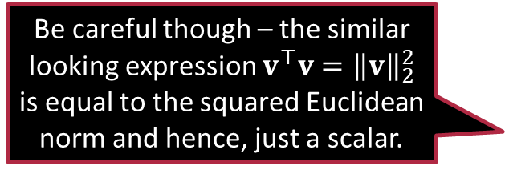

Applying Calculus to Find My Salary
$$ℓ\left(w,b\right)≝\frac{1}{n}\sum_{i=1}^{n}{{\left({\hat{y}}^{i}−y^{i}\right)}^{2}}=\frac{1}{n}\sum_{i=1}^{n}{{\left(\left(w^{⊤}x^{i}+b\right)−y^{i}\right)}^{2}}$$
Lets simplify by hiding the bias by taking ${\tilde{x}}^{i}=\left[x^{i},1\right],\tilde{w}=\left[w,b\right]$ $ℓ\left(\tilde{w}\right)≝\frac{1}{n}\sum_{i=1}^{n}{{\left({\tilde{w}}^{⊤}{\tilde{x}}^{i}−y^{i}\right)}^{2}}$
Let $ℓ_{i}\left(\tilde{w}\right)≝{\left({\tilde{w}}^{⊤}{\tilde{x}}^{i}−y^{i}\right)}^{2}={\left({\tilde{w}}^{⊤}{\tilde{x}}^{i}\right)}^{2}+{\left(y^{i}\right)}^{2}−2⋅y^{i}⋅{\tilde{w}}^{⊤}{\tilde{x}}^{i}$
$∇{\left(y^{i}\right)}^{2}=0$ since $y^{i}$ are the “ground-truth” labels and don’t depend on $\tilde{w}$
$∇\left(2⋅y^{i}⋅{\tilde{w}}^{⊤}{\tilde{x}}^{i}\right)=2⋅y^{i}⋅{\tilde{x}}^{i}$ using the scaling rule and an identity
$∇\left({\left({\tilde{w}}^{⊤}{\tilde{x}}^{i}\right)}^{2}\right)=∇\left({\tilde{w}}^{⊤}{\tilde{x}}^{i}{{\tilde{x}}^{i}}^{⊤}\tilde{w}\right)=2⋅{\tilde{x}}^{i}{{\tilde{x}}^{i}}^{⊤}\tilde{w}$ using an identity and the fact that dot products are symmetric i.e., $u^{⊤}v=v^{⊤}u$
Be careful though – the similar looking expression $v^{⊤}v={\left\|v\right\|}_{2}^{2}$ is equal to the squared Euclidean norm and hence, just a scalar.
If $v=\left[v_{1},v_{2},…,v_{d}\right]∈ℝ^{d}$ is a vector then $vv^{⊤}$ is actually a $d×d$ square symmetric matrix whose $\left(i,j\right)$-th entry is $v_{i}v_{j}$

Slide 22



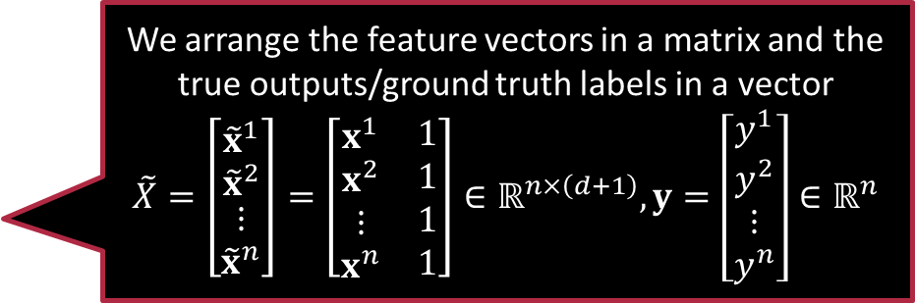

Applying Calculus to Find My Salary
By sum rule $∇ℓ\left(\tilde{w}\right)=\frac{2}{n}\left(\sum_{i=1}^{n}{{\tilde{x}}^{i}{{\tilde{x}}^{i}}^{⊤}}\right)\tilde{w}−\frac{2}{n}\left(\sum_{i=1}^{n}{y^{i}⋅{\tilde{x}}^{i}}\right)$
A $ℓ\left(\tilde{w}\right)$ is differentiable, the minima must be one of the stationary pts $\left({\tilde{X}}^{⊤}\tilde{X}\right)\tilde{w}={\tilde{X}}^{⊤}y$
If ${\tilde{X}}^{⊤}\tilde{X}∈ℝ^{\left(d+1\right)×\left(d+1\right)}$ is invertible, then the solution must be $\tilde{w}={\left({\tilde{X}}^{⊤}\tilde{X}\right)}^{−1}\left({\tilde{X}}^{⊤}y\right)$
But what if ${\tilde{X}}^{⊤}\tilde{X}$ is not invertible?
We arrange the feature vectors in a matrix and the true outputs/ground truth labels in a vector $$\tilde{X}=\left[\begin{matrix}{\tilde{x}}^{1} \\ {\tilde{x}}^{2} \\ \begin{aligned}⋮ \\ {\tilde{x}}^{n}\end{aligned}\end{matrix}\right]=\left[\begin{matrix}\begin{aligned}x^{1} \\ x^{2} \\ ⋮ \\ x^{n}\end{aligned} & \begin{aligned}1 \\ 1 \\ 1 \\ 1\end{aligned}\end{matrix}\right]∈ℝ^{n×\left(d+1\right)}, y=\left[\begin{aligned}y^{1} \\ y^{2} \\ ⋮ \\ y^{n}\end{aligned}\right]∈ℝ^{n}$$
Then we need to apply other learning techniques such as regularization which we will study later.

Slide 23

Summary
Calculus techniques play a major role in designing ML algorithms
For $f:ℝ→ℝ$, its derivative $f^{′}\left(x\right)$ tells us how the function output value will vary if we make a tiny change to its input value
The sign tells if the output will go up or down if we increase the input a little bit
The magnitude tells us how sensitive is the output to changes in the input
Stationary points (max, min, saddle) are where the derivative is zero
For $f:ℝ^{d}→ℝ$, its gradient $∇f\left(x\right)$ plays the same role
$∇f\left(x\right)∈ℝ^{d}$ and its $i$-th coordinate tells us how the output value will change if the $i$-th coordinate of input is changed keeping all other coordinates fixed
The gradient gives us the direction of steepest ascent for the function output value and the direction opposite to it is the direction of steepest ascent

Slide 24
Stay Amazing!
Hang-out with you in the next one

